Slide 1
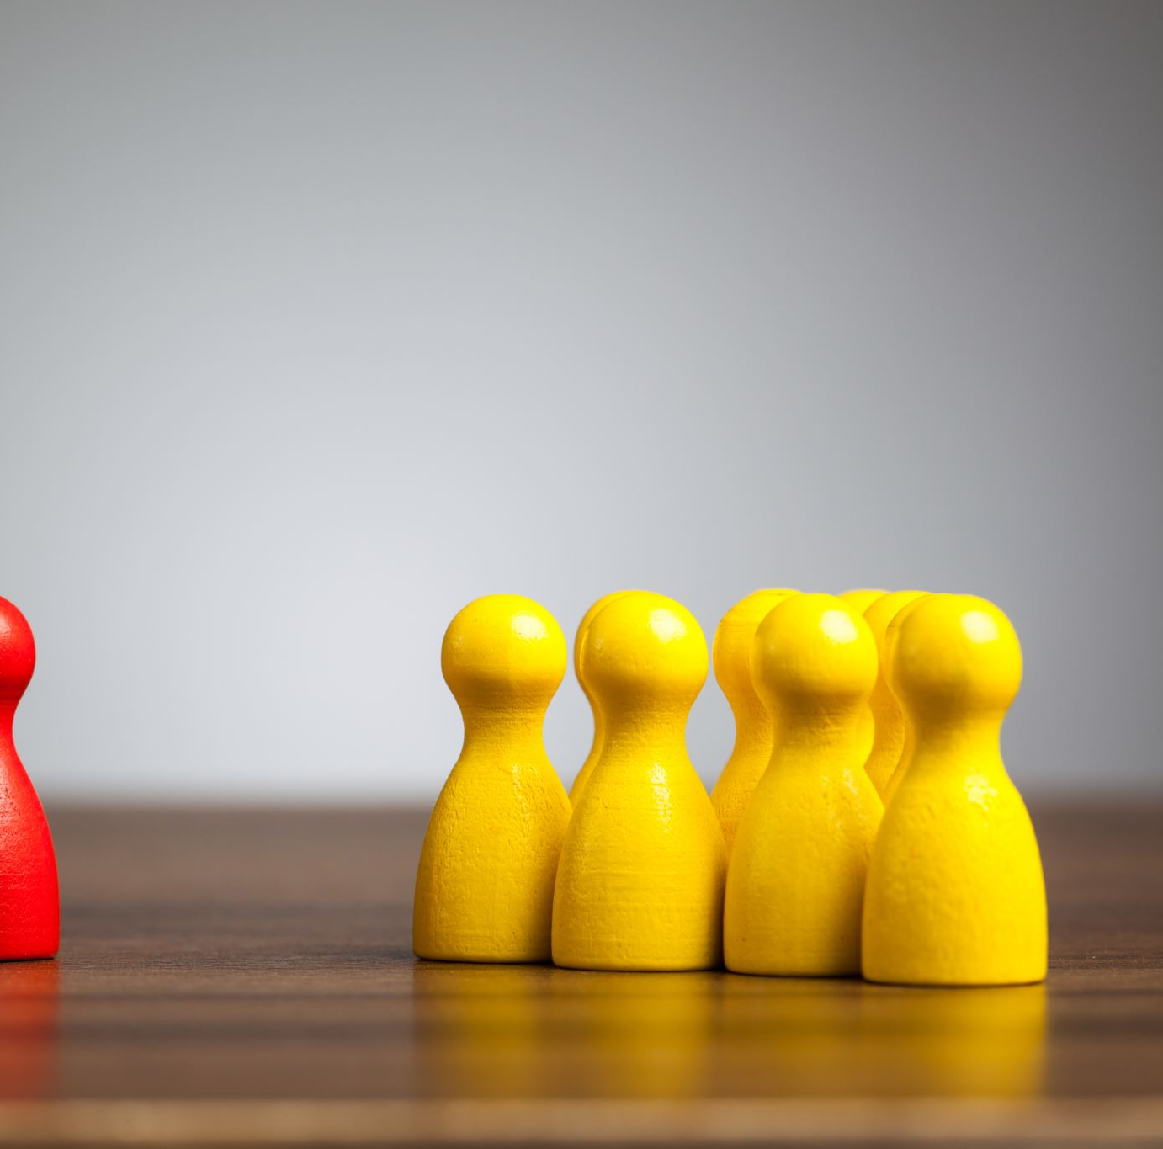
Individual VS Group Fairness in AI
ROSSI NICOLE
ROUMILA YOUNES
SHANKS DAY
SHARIPOV JOE
CS312

Slide 2
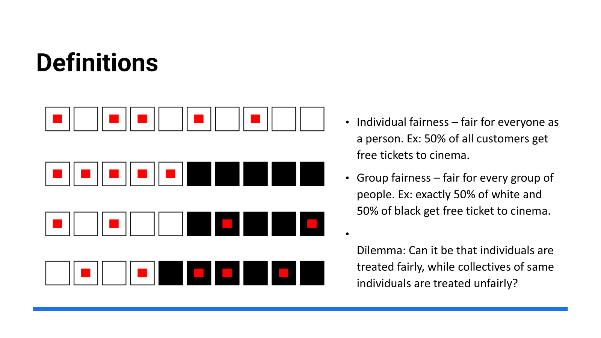
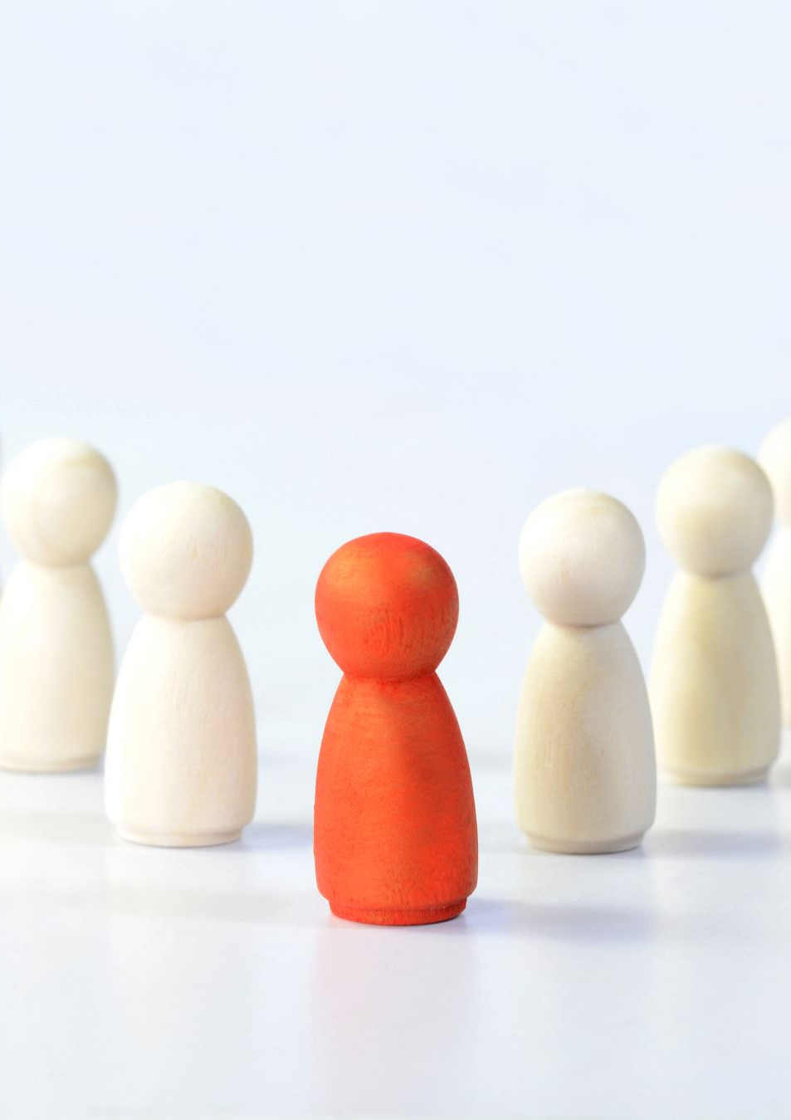
Definitions
individual fairness
individual fairness
group fairness
group fairness

Slide 3

ProPublica VS COMPAS
ProPublica – non-profit newspaper – investigative journalism
COMPAS – An AI tool developed by Northpointe INC. to determine whether bail should be granted?

Slide 4
The data which COMPAS used to predict:
Criminal History, past convictions, time since last offense.
Age, gender and other demographic
Education and employment.
Drug or Alcohol convictions.
Mental Health History.
Social history, history of domestic violence and child abuse.

Slide 5
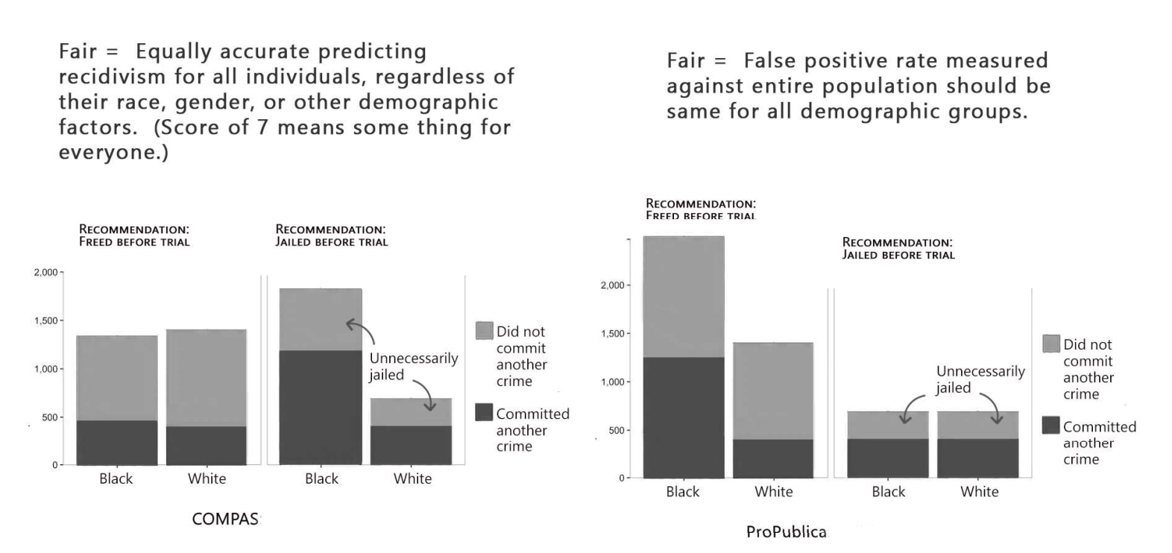
ProPublica Argument.
Notes:
The graph will be explained in the speech

Slide 6
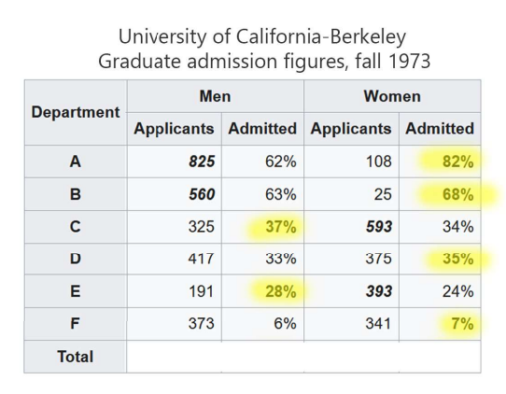
Simpson’s Paradox
(Proportion Confusion)
The Simpson’s Paradox is where a trend appears in several groups of data, but disappears when those groups are combined
Based off the top chart, it’s assumed Berkeley is biased towards women
However based on the final total, the bias is towards men instead.
Notes:
More men applied to easier positions and were admitted, while women in general mostly applied to harder positions. Its why overall more men were admitted
Individual fairness is much easier to test, but groups are complicated due to problems like the simpsons paradox

Slide 7
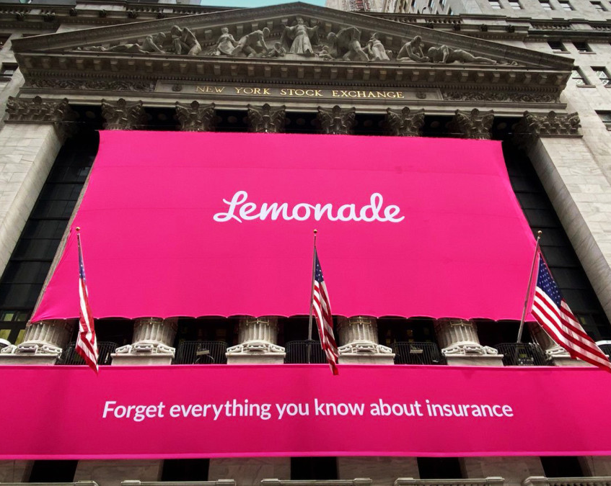

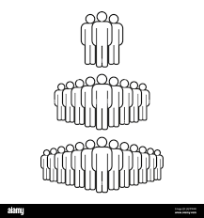
Lemonade insurance
Everyone
Groups
Individuals
Notes:
Use AI to evaluate everyone to determine their risk and insurance
Each person gets individual rate instead of multiple people getting same rate

Slide 8

Lemonade candles
Burning candles increases fire risk
People who burn candles get higher rates
Who is more likely to burn candles?
Does this defeat the point of insurance?
Notes:
The AI associates burning of candles with higher fire risk
Jewish people are more likely to burn candles regularly for shabbat
Other people who burn candles get higher rates
Insurance is a collective of people with some who need a lot and others who dont

Slide 9
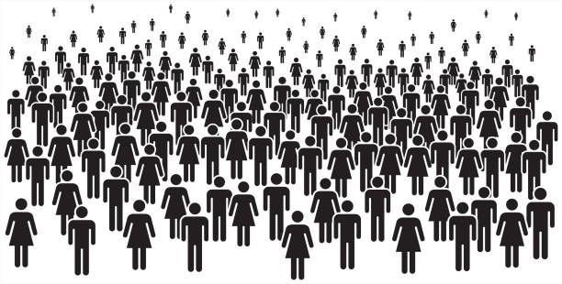
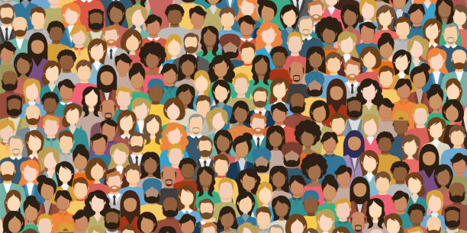
Privacy v. Fairness
Notes:
Fairness is not free
To ensue fairness in AI some privacy has to be given up
Hiring AI not hiring anyone over 55
Only way to know its not hiring them and not another reason is to know an applicants age
Lemonade - only way to know jewish people were affected is by knowing they're jewish

Slide 10
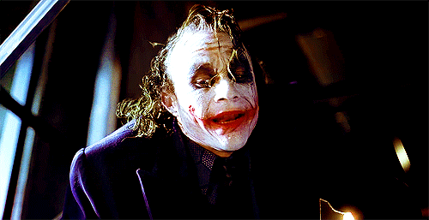
Fairness in AI Hiring Algorithms: Bias, Proxies, and Perception
Let’s explore how artificial intelligence mirrors and magnifies human judgement in hiring decisions
Day Shanks

Slide 11
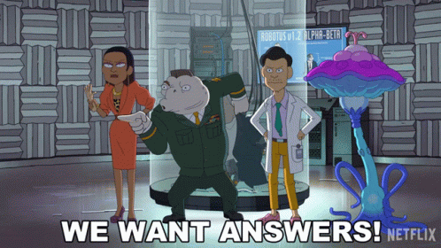
Some Key Terms
What is a “Bias”?
What are “Proxies”?
What is “Perception”?

Slide 12
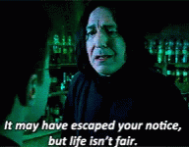
What is Fairness?
Aristotle: “Treat equally, and unequals proportionately unequally.”
Context matters: fairness in basketball ≠ fairness in law or tech.
AI often allows patterns without understanding the context.

Slide 13
Let’s Look At Some Case Studies
Retorio AI
Amazon AI
Rates personality from video interviews.
Visual features (glasses, headscarves, books) affect scores.
Trained on 2,500 human raters → mimics human preferences.
Doesn’t pick the best candidate–just who humans think looks best.
Trained on past employee data → mostly men
AI learned to prefer men even after gender was removed.
Proxy Bias: gender inferred from things like schools or clubs
Past data bias = future prediction bias.

Slide 14
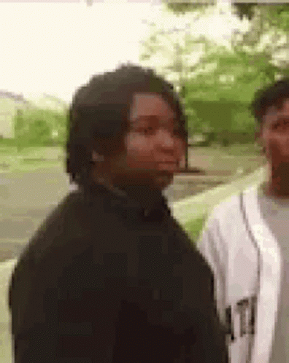
Invisible and Accidental Bias
AI can discriminate based on irrelevant patterns.
Example: last names A-M hired more often = pattern AI replicates.
Random Bias still feels unfair, even if it’s unintentional.
Nobody notices…until it’s too late.

Slide 15
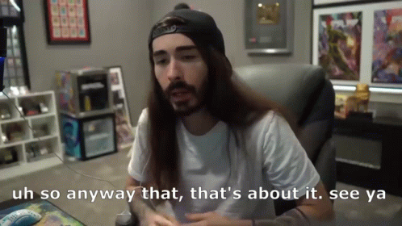
Final Questions & Takeaways
Can AI ever be truly fair?
Should developers intervene to “rebalance”?
Is randomness more fair than bias?
AI doesn’t understand why–it just replicates what.

